Slide 1
Team 5 – Interim Progress Presentation
Lab Group 5: Christopher Barkowsky, Mark Dannemiller, Brett Fischbuch

Slide 2
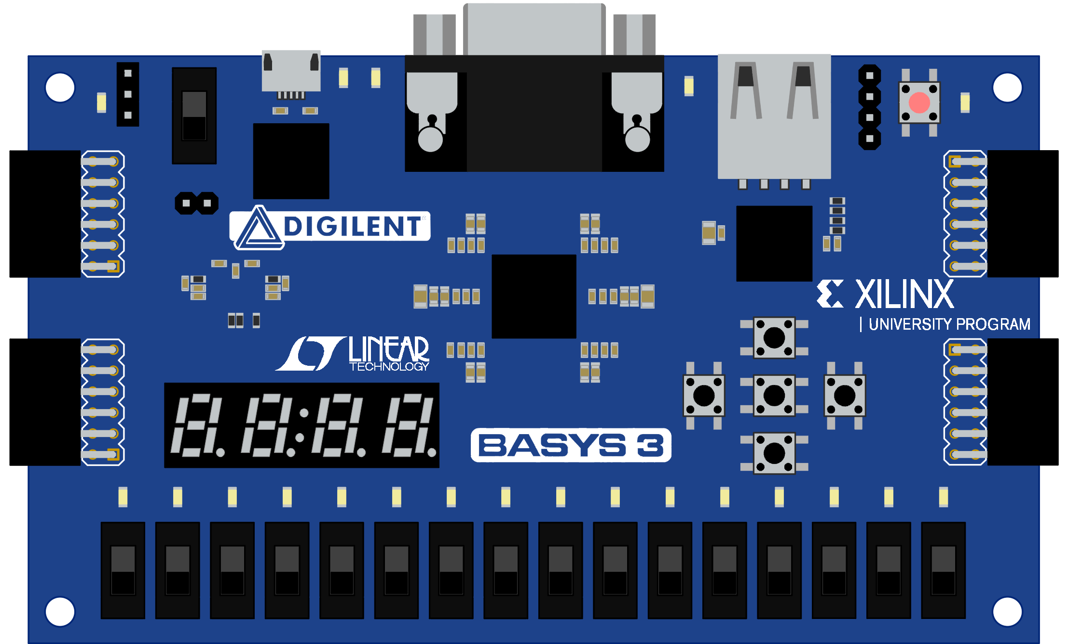
Project Description
Using the supplied rover chassis, construct an autonomous robot that will:
Follow a track made of metallic tape hidden under carpet
Detect randomly placed bins placed on the outside of the track
Detect numbered morse infrared pulses from emitter mounted on bins
Dispense the appropriate number of marbles into each bin
Robots will be judged based on time of track completion and performance of designed systems
**Rover shall be controlled via BASYS 3 FPGA**

Slide 3
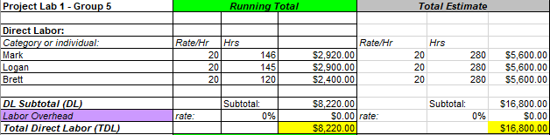
Budget – Direct Labor
Budgeted for 20 hours per person per week
Averaging 17.125 hours per person per week

Slide 4
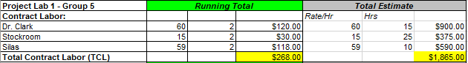
Budget – Contract Labor
Consultant use was intended to reduce direct labor costs
Less necessary than anticipated
Stockroom utilization was overestimated
Significantly under budget

Slide 5
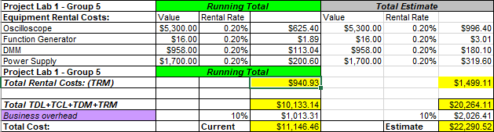
Budget – Rental and Total
Rental costs as expected
Overall, significantly under budget

Slide 6
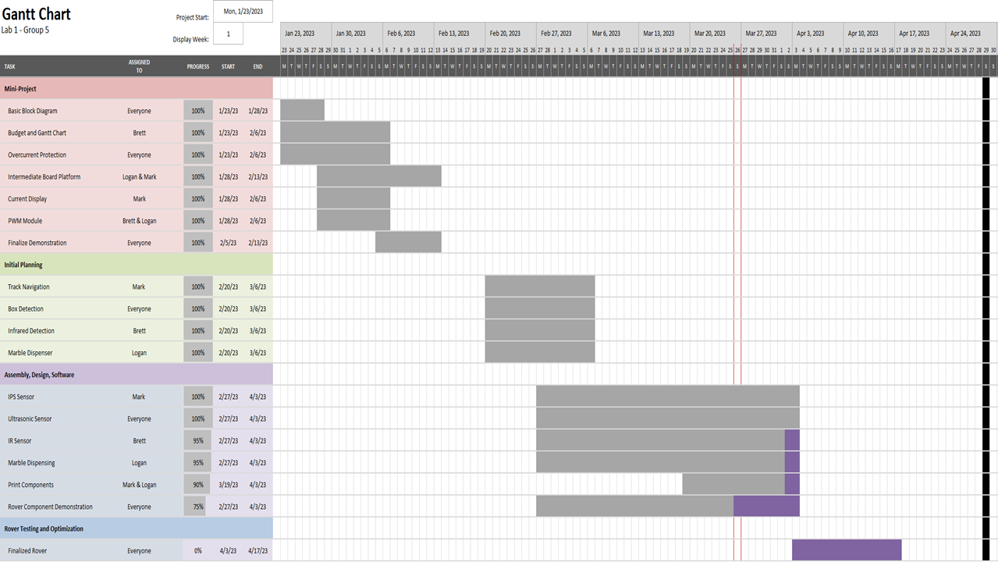

Slide 7
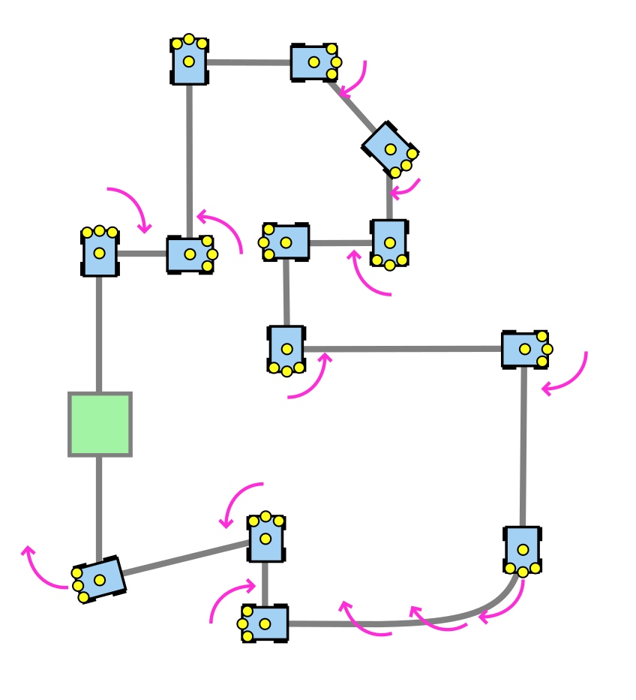
Track Navigation - Components
HOURS WORKED: 196 hours
Design Pulse Width Modulation (PWM) module for variable speed
Design hardware and software overcurrent protection
Select a sensor to detect the metallic tape
Choose sensor quantity and configuration
Track navigation state diagram
Develop a Verilog module to handle variations in the track
Software interrupts for bin detection
Design and print sensor housing

Slide 8
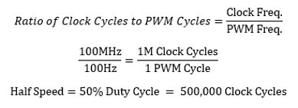
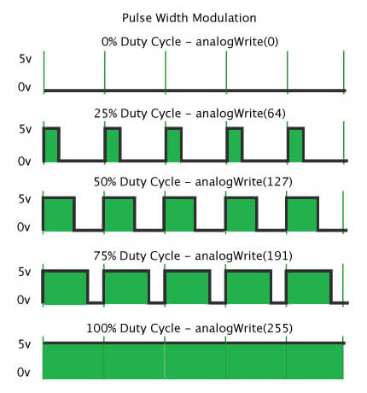
Track Navigation – PWM
Necessary to control the speed and direction of the rover
Required conversion of BASYS clock cycles into PWM cycles to set frequency
Decided on 100 Hz for motor after testing
Motor Control handles direction and on/off state
PWM designed with 4-bit selection, offering 16 speeds
Lower duty cycles draw higher current spikes, necessitating overcurrent protection
https://www.circuitgeeks.com/arduino-pwm/

Slide 9
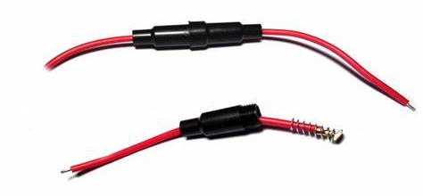
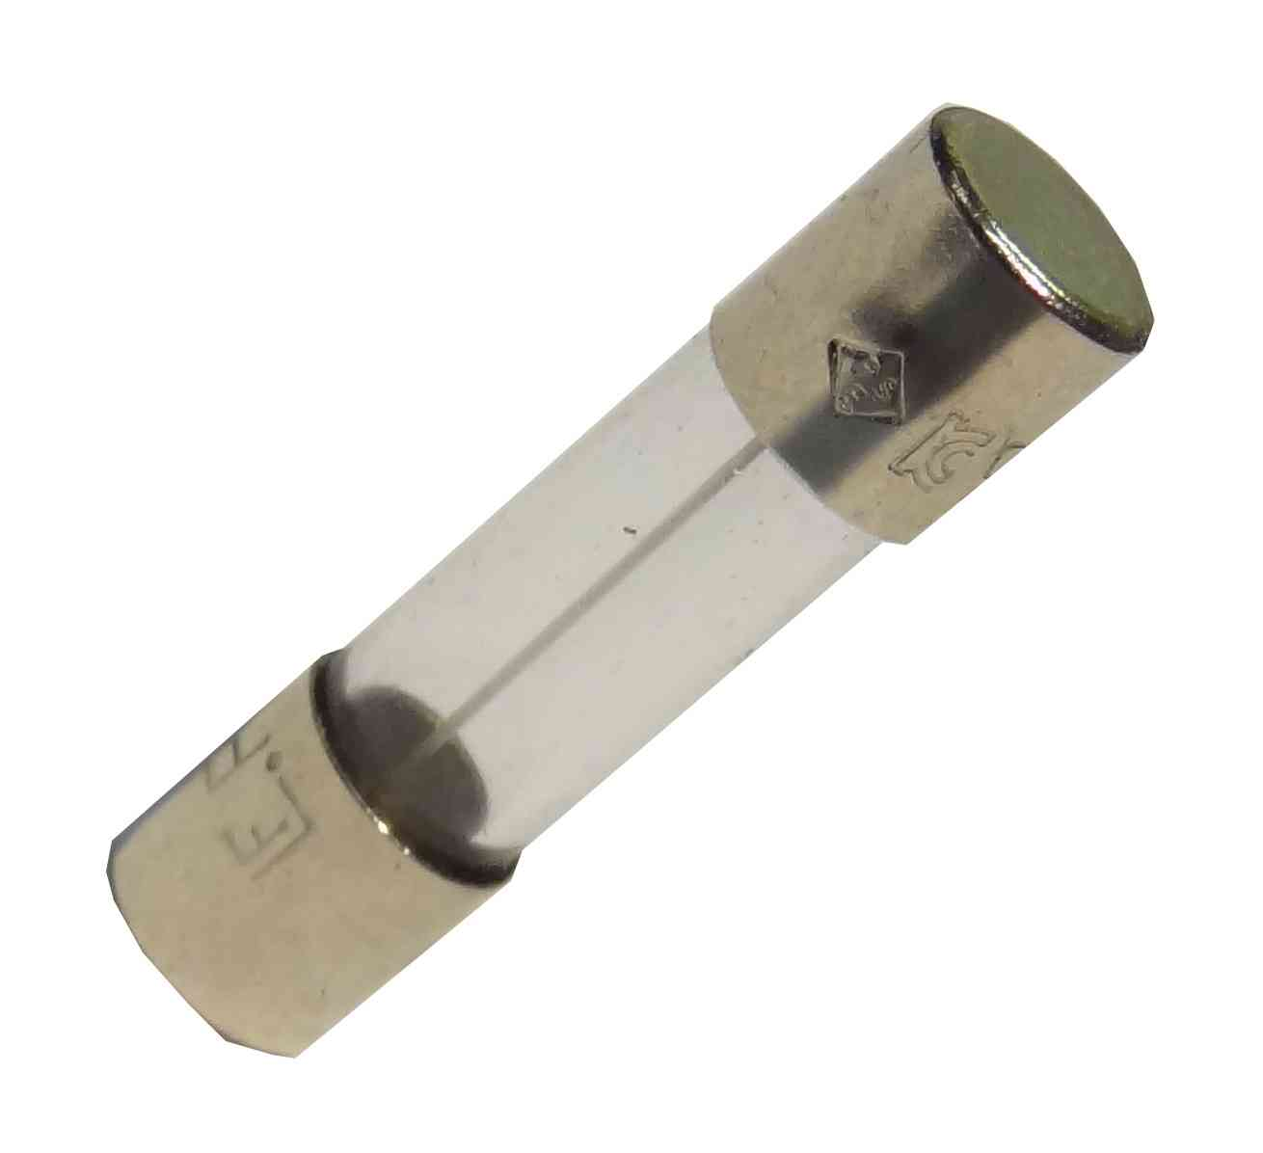
Track Navigation – Overcurrent Protection
Necessary to avoid destroying sensitive components
1 A fuses were placed between each motor’s connection to the H-Bridge
We tested with the provided voltage supply to avoid unnecessary fuse expenditure during software overcurrent protection development
Fuses only trigger after prolonged periods beyond rated current
http://www.fleconn-china.com/productinfo-263-6mm-x-30mm-6x30mm-Glass-Tube-Fuse-Holder-Case-In-Line-Screw-type-with-18AWG-Wire-Cable.html
https://www.stevensonplumbing.co.uk/20mm-glass-fuse-1a-fast.html

Slide 10
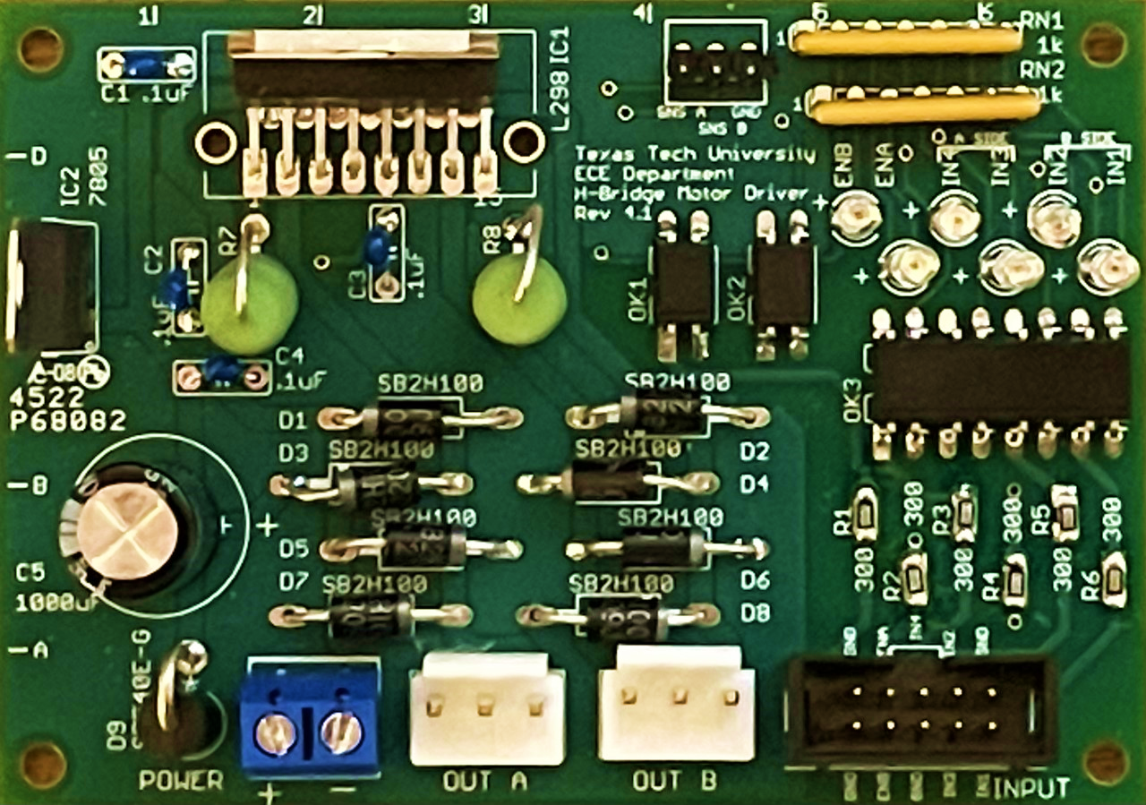

Track Navigation – Overcurrent Protection
Software protection designed to monitor current data from the SNSA and SNSB pins
Pins measure the voltage across the 1Ω power resistors
The protection module stores the highest current value registered each millisecond
Triggers after the current exceeds 1 A for a 1 second period to avoid tripping due to spikes in current caused by change in direction or abrupt starts/stoppages
$$Voltage = \frac{Current}{Resistance}=\frac{Current}{1 Ω}=Current$$

Slide 11
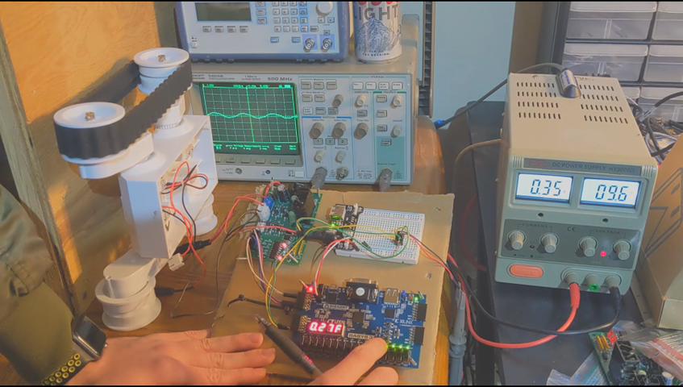
Track Navigation – Overcurrent Protection
The protection module stores the highest current value registered each millisecond
Triggers after the current exceeds 1 A for a 1 second period to avoid tripping due to spikes in current caused by change in direction or abrupt starts/stoppages
Overcurrent utilizes onboard XADC of Basys
Measures difference between 2 voltage references. Decimal conversion required
video

Slide 12
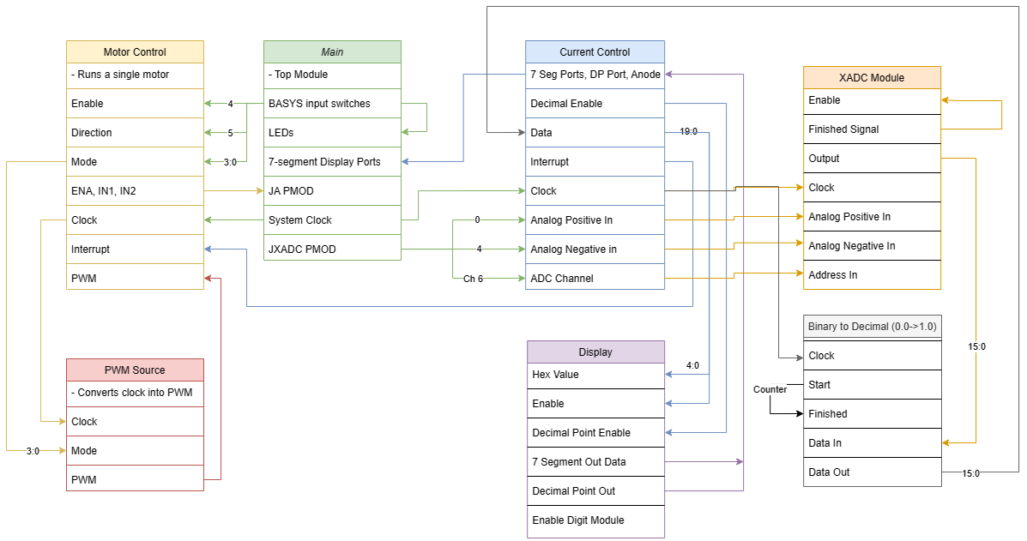
Track Navigation – Motor Control Diagram

Slide 13
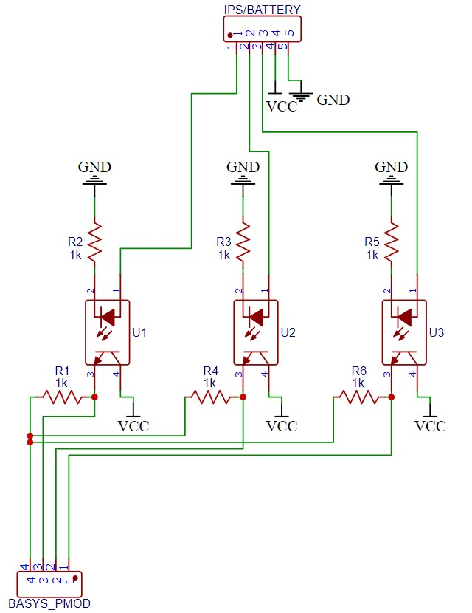
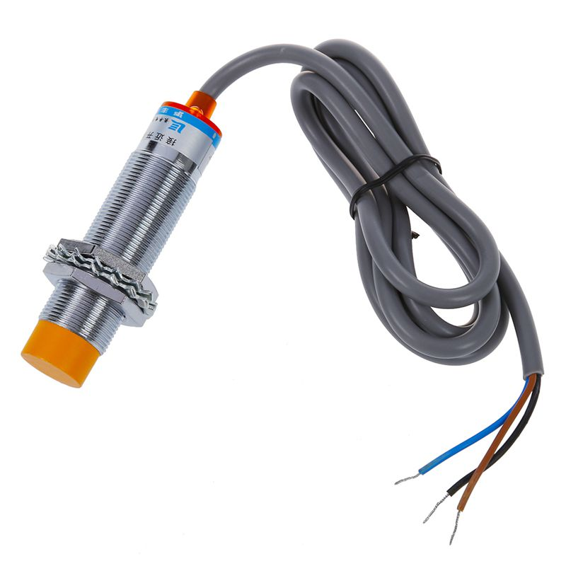
Track Navigation – IPS Sensor
Chose this sensor because of availability
Maximum detection distance of 8mm
Effective detection distance of 4mm – 6mm
Takes 12V supply power
Requires optocoupling to BASYS board
https://www.ebay.com/p/1769049052?iid=173389201737

Slide 14
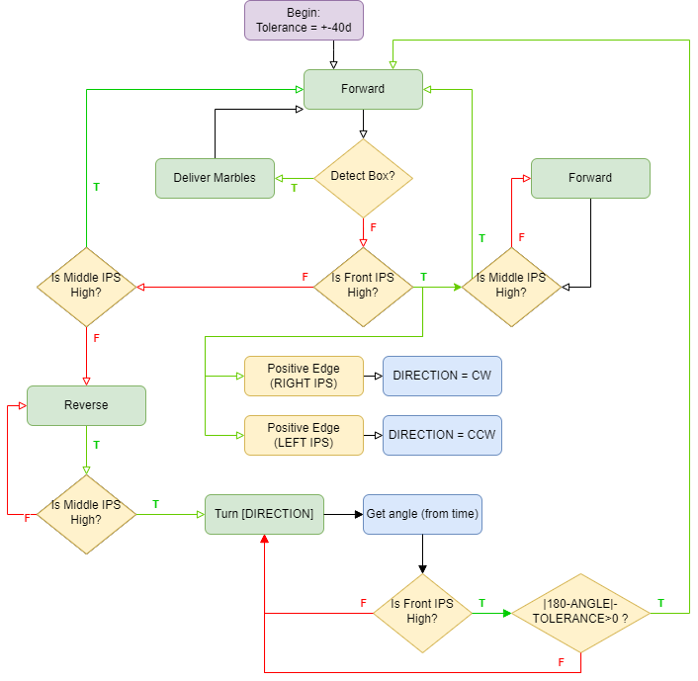
Track Navigation – Verilog Module
Module controlled by state diagram
1 = FORWARD
2 = REVERSE
3 = ROTATE
4 = FORWARD SPECIAL
Controlled through switch statement in IPS module
States switched by state of front / middle IPS
Direction controlled by states of left / right IPS

Slide 15
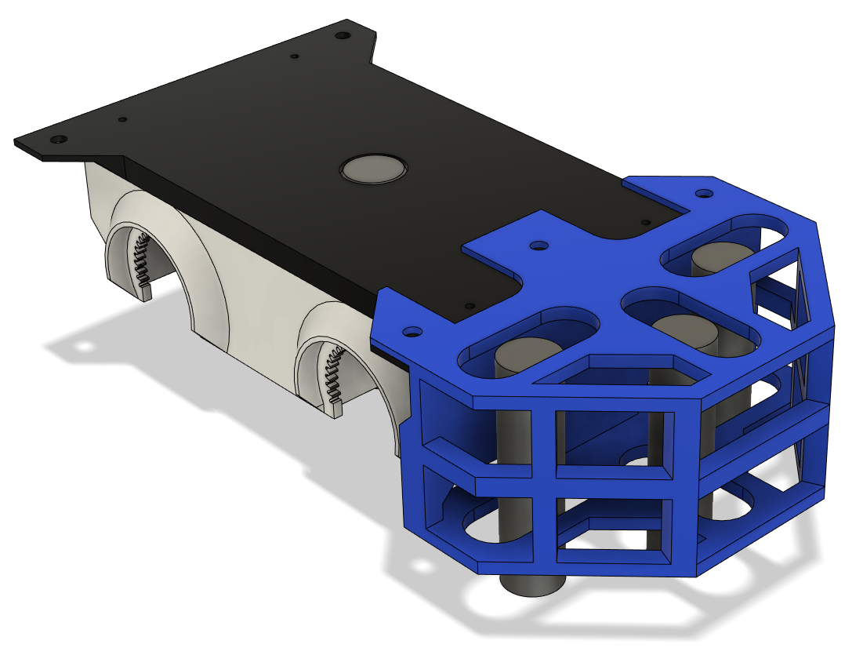
Track Navigation – IPS Carrier Assembly
The IPS Carrier Assembly houses 3 separate IPS sensors, with the fourth being housed inside chassis
Allows for adjustment in all directions and makes fine-tuning possible to allow for precise detection of upcoming turns or curves

Slide 16
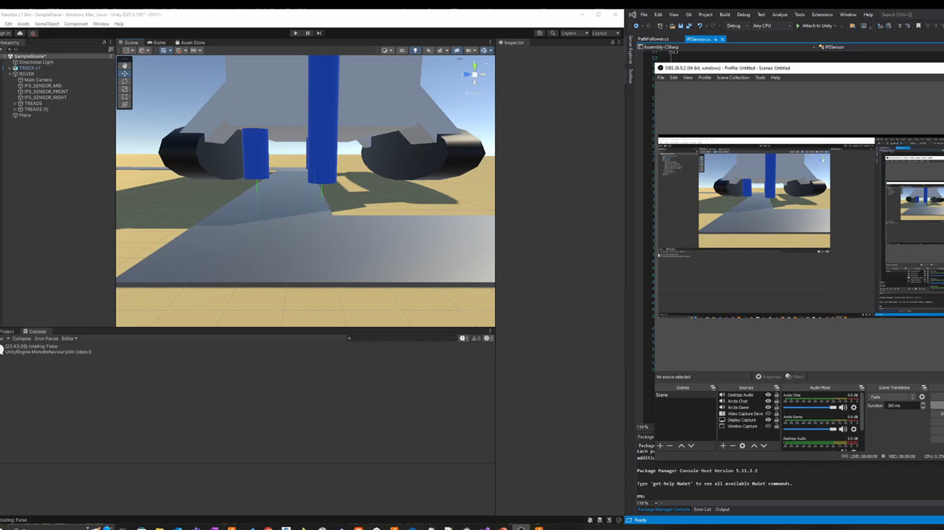
Track Navigation – Unity Simulation
video

Slide 17
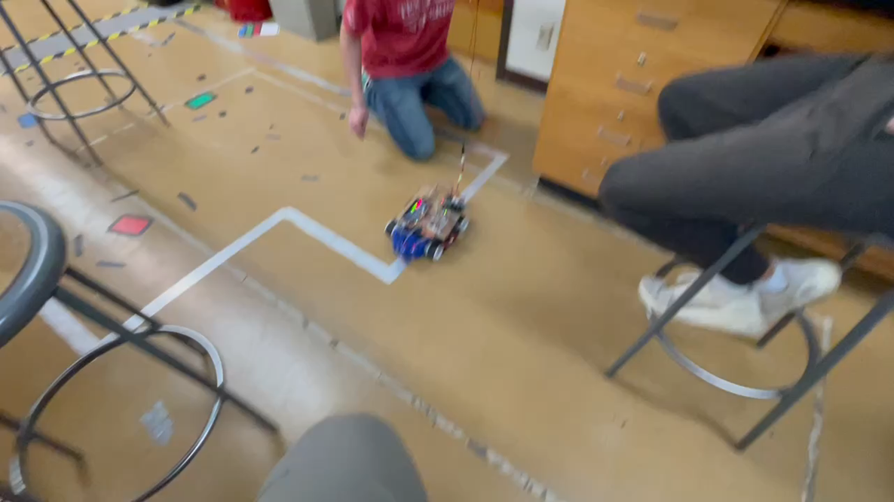
Track Navigation – Demonstration
video

Slide 18
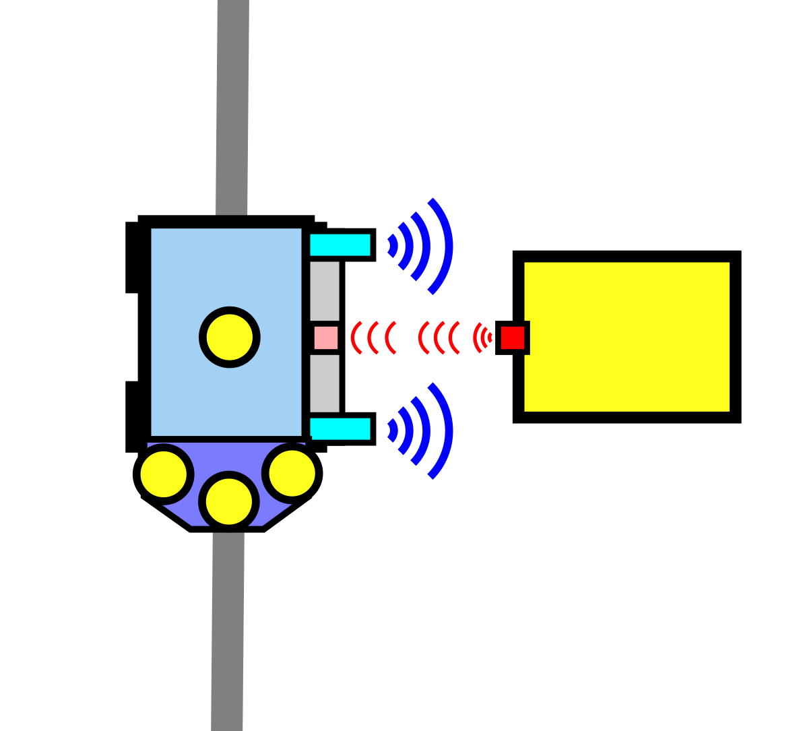
Bin Detection - Components
HOURS WORKED: 51
Select a sensor
Choose sensor quantity and configuration
Design a circuit to link sensor to the BASYS board
Develop a Verilog module to receive sensor inputs and send BASYS outputs
Send enable signal to infrared module on successful box detection
Design and print sensor housing
BIN

Slide 19
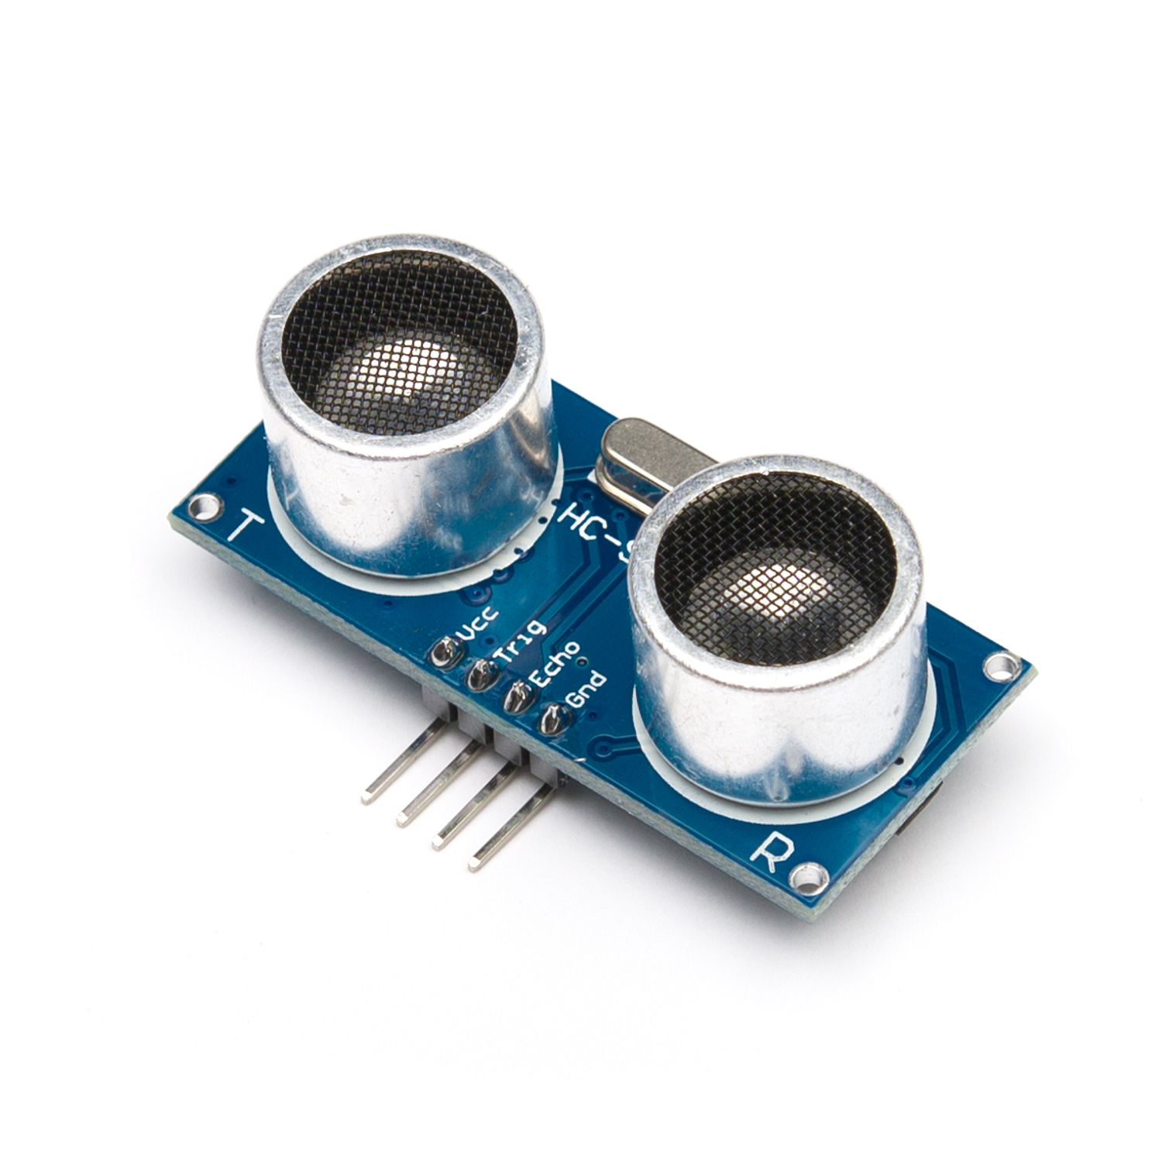
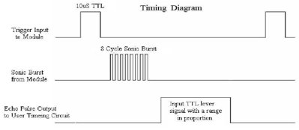
Bin Detection – Sensor & Configuration
Decide upon HC-SRO4 ultrasonic sensors due to their availability and well-documented use
Two will be used, one at the front of the rover for initial bin detection, and another at the rear for proper alignment with infrared sensor
Once the sensor receives a 10 μs pulse, it will emit an 8-cycle sonic burst, and receive an echo of that signal
Bin distance is calculated based on the length of received echo
https://littlebirdelectronics.com.au/products/ultrasonic-distance-sensor-hc-sr04

Slide 20
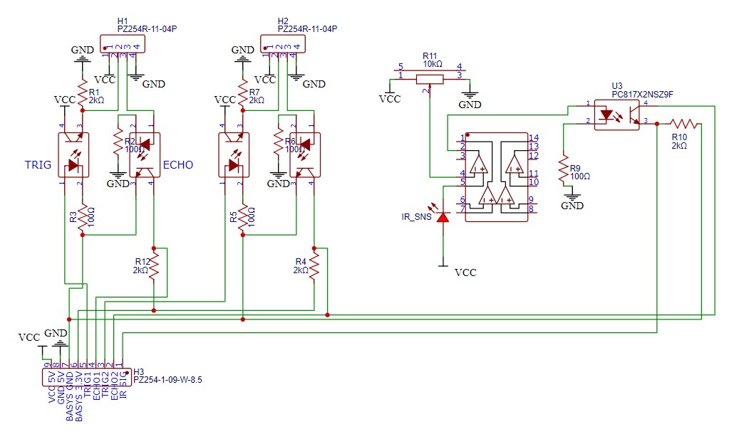
Bin Detection - Circuit
BASYS board sends the trigger signal to activate the ultrasonic pulse through an optocoupler
BASYS board receives the varying length echo signal through another optocoupler
Pulldown resistors are utilized to isolate random noise
Pullup resistors are used to invert the logic

Slide 21
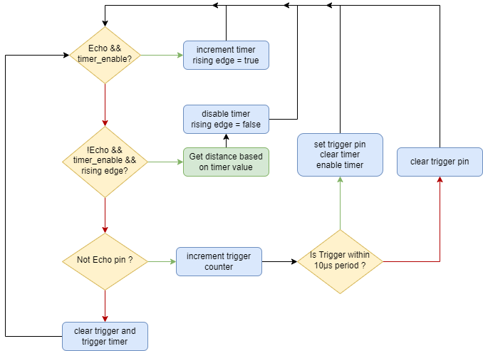
Bin Detection – Verilog Module
Detects bin based on calculated distance of detected surface
Can be tuned for more precise box detection
Only enabled while rover is moving
Upon second sensor detecting the bin, will send enable signal to the infrared detection module and send a signal to stop to the motor control module
Has a short restart delay after successful marble dispensing

Slide 22
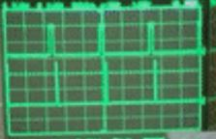
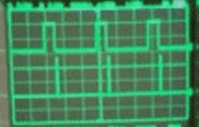
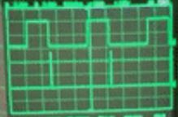

Slide 23
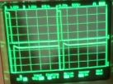
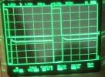
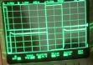

Slide 24
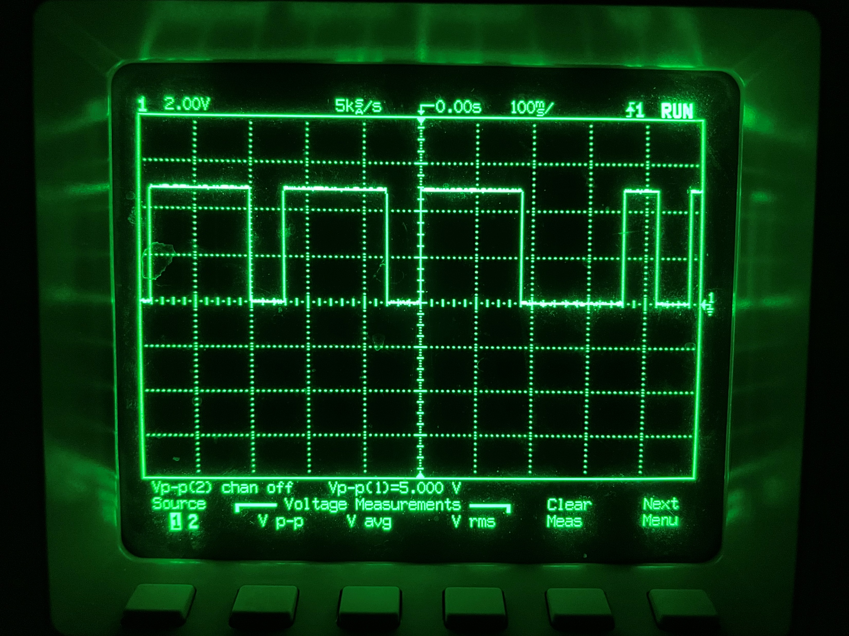
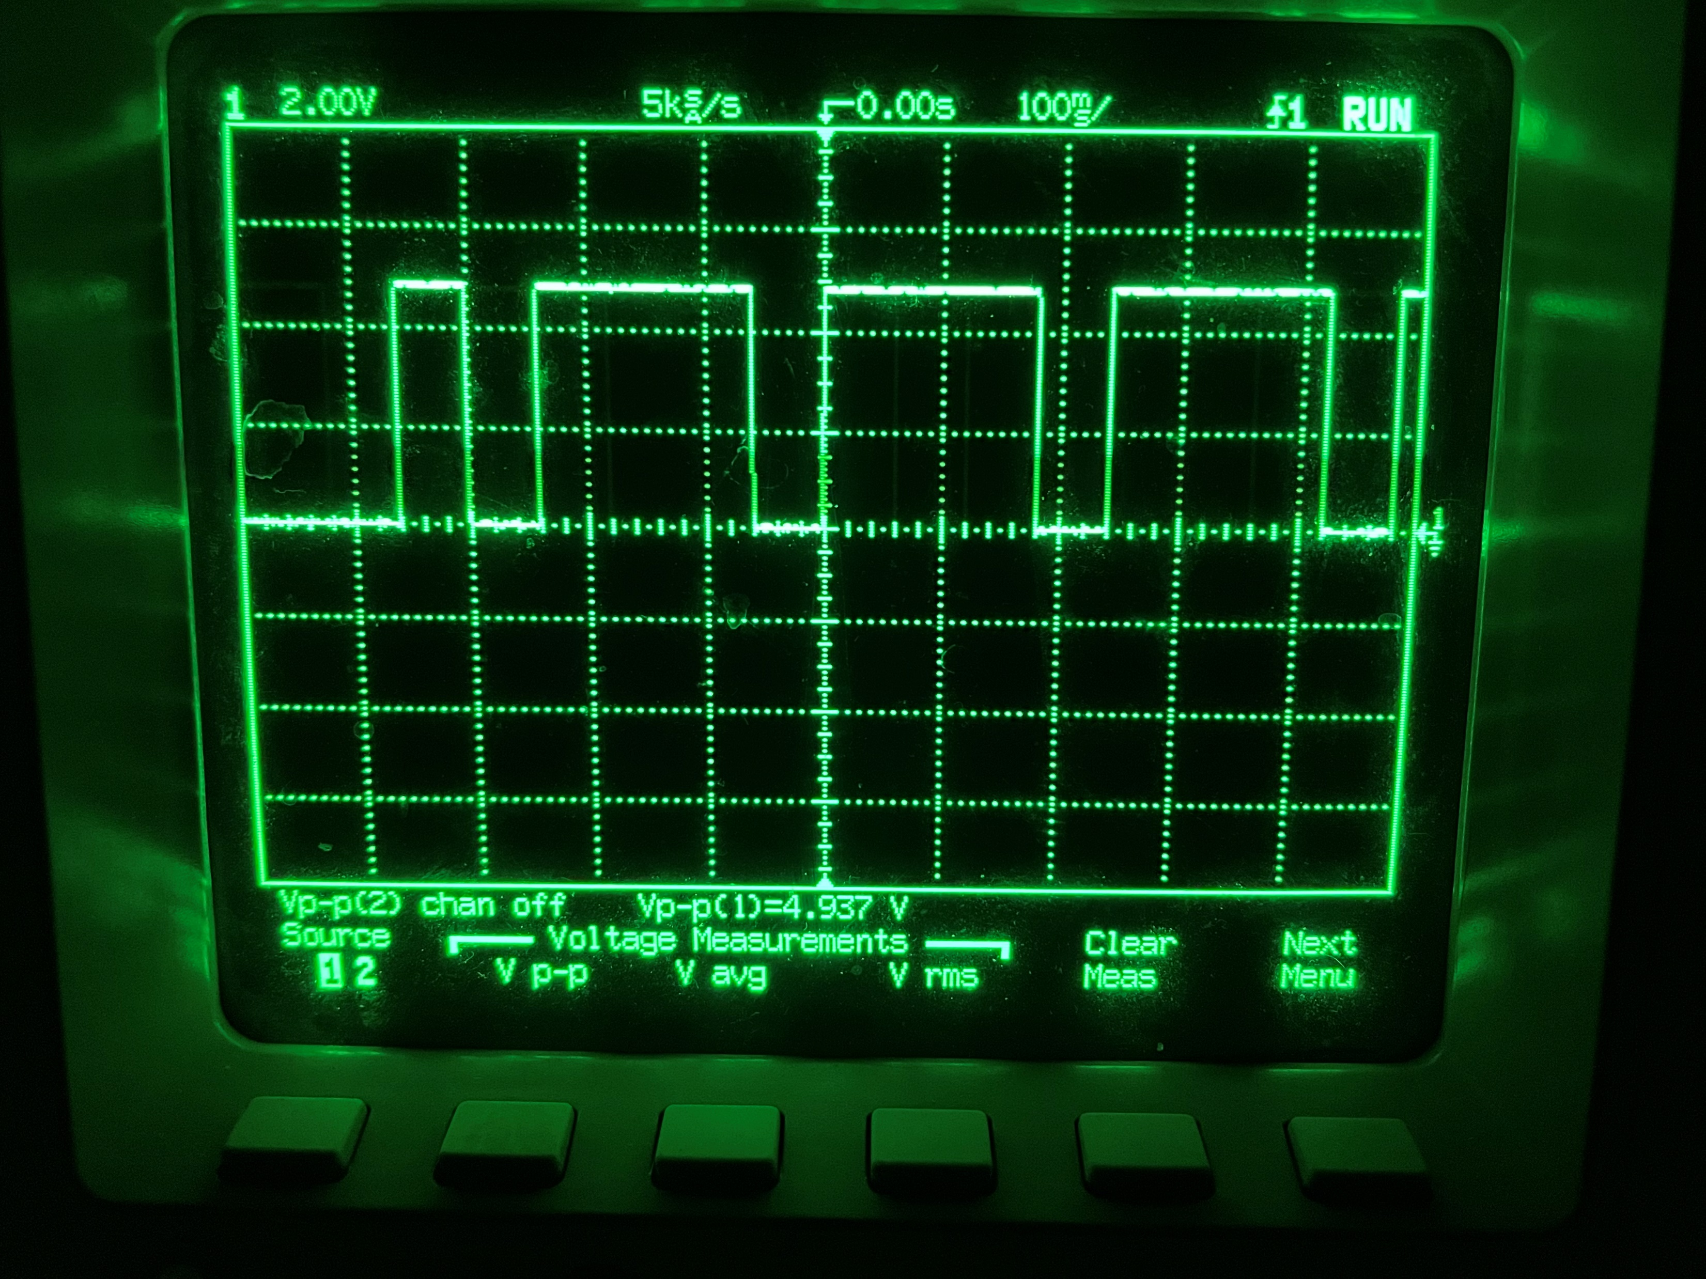
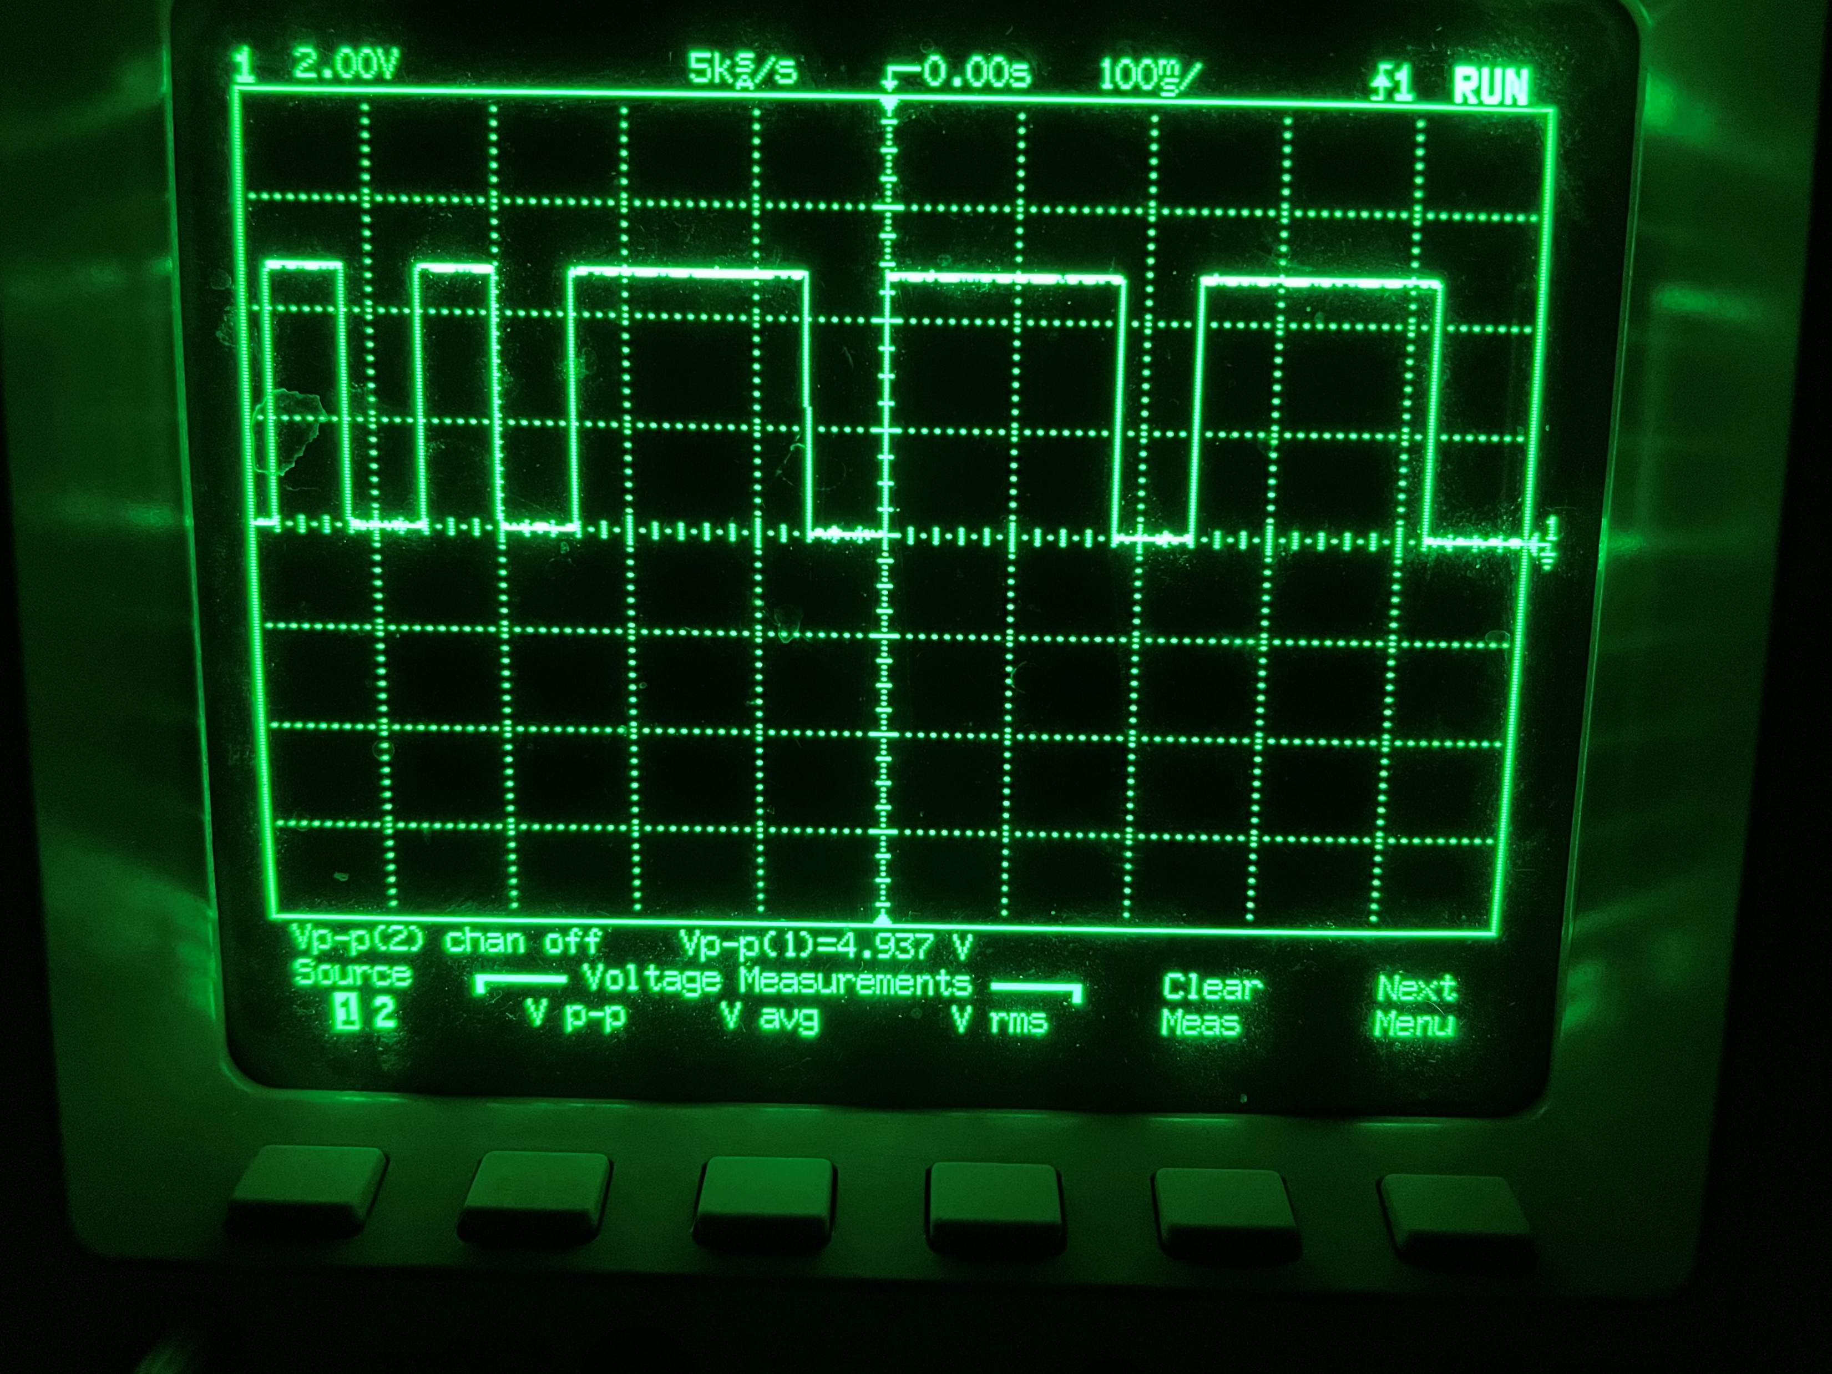
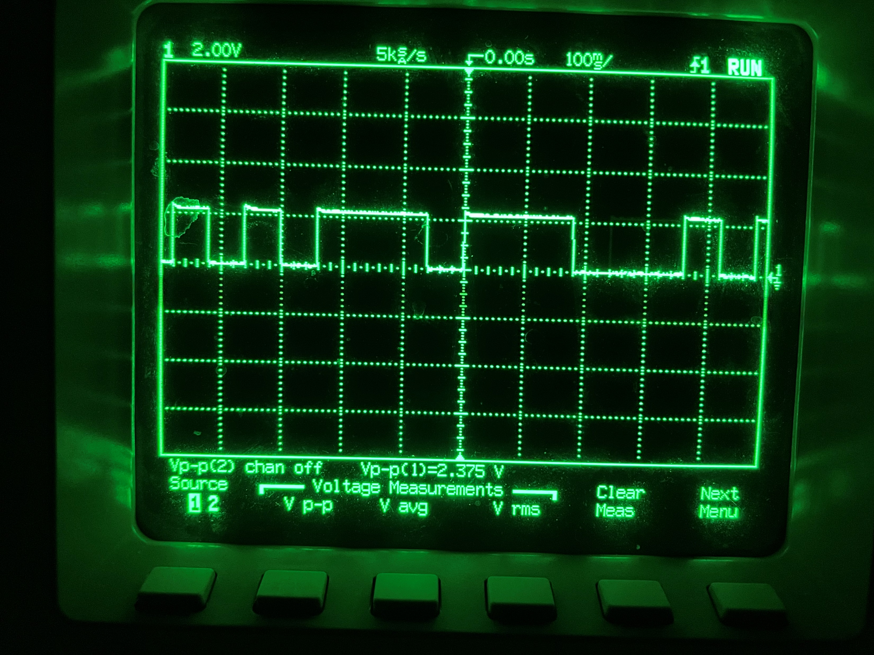
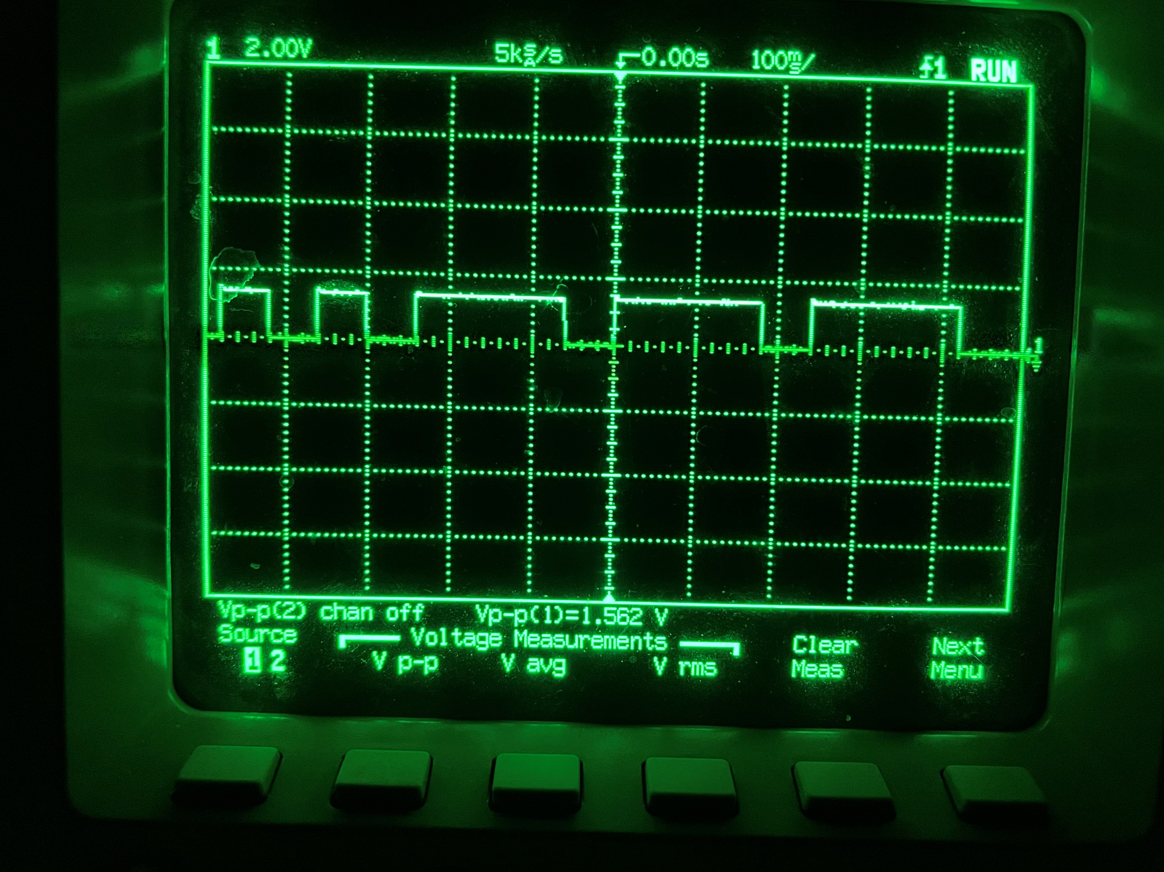
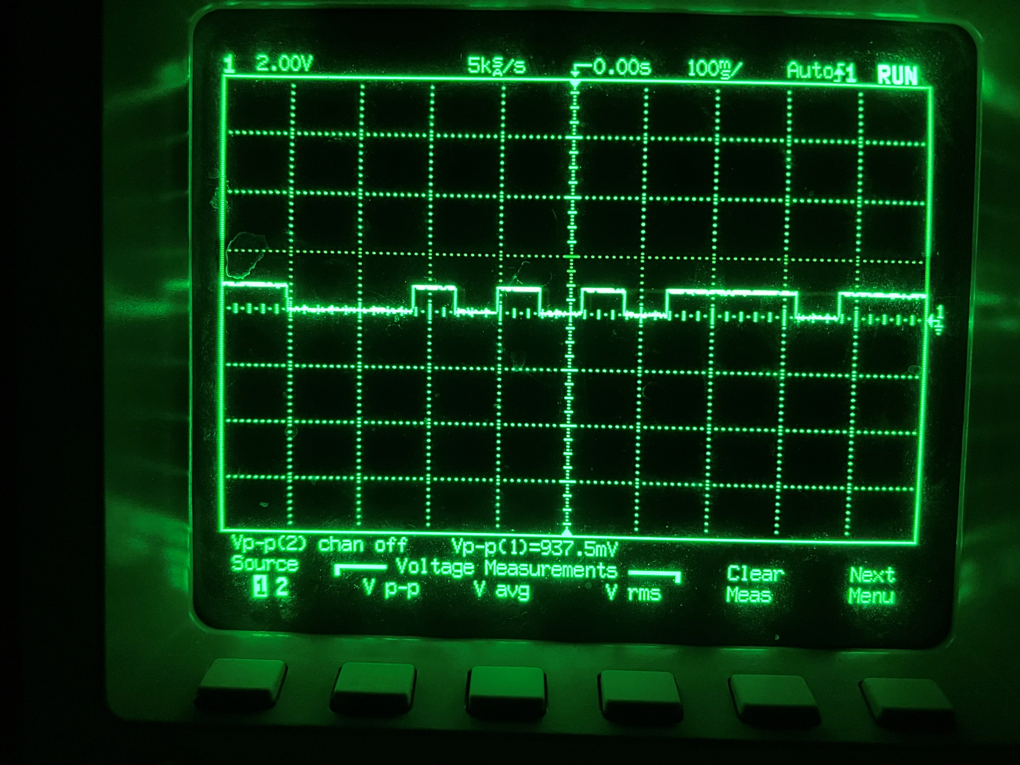

Slide 25
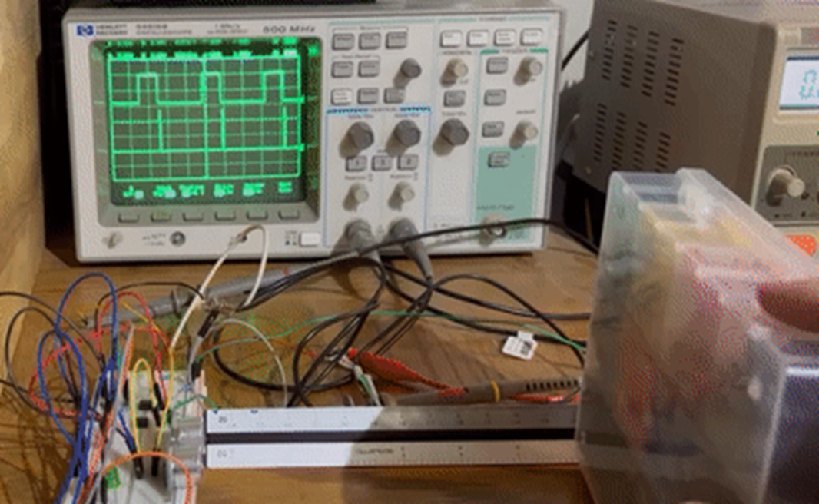
Bin Detection – Sensor Demonstration
video

Slide 26
Infrared Detection - Components
HOURS WORKED: 99
Select a sensor
Choose sensor quantity and configuration
Design a circuit to receive infrared pulses and transmit input to BASYS board
Develop a Verilog module to receive and store input from designed infrared circuit then convert stored input into a decimal number
Send decimal number to marble dispenser module
Design and print sensor housing
BIN

Slide 27
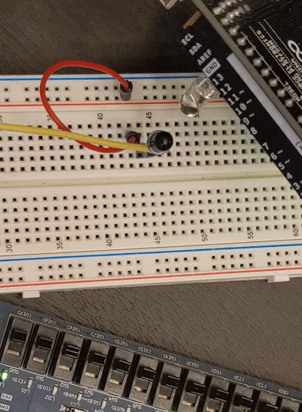
Infrared Detection – Sensor + Configuration
OP593 phototransistor chosen to detect the infrared pulses of the morse emitter
Sensor will be centered vertically and horizontally on the PDU
Circuit is simply the phototransistor attached to an optocoupler, relaying inputs to BASYS board
Circuit is shown receiving morse infrared pulses from an infrared emitting LED through an Arduino UNO, as indicated by the 3rd BASYS LED

Slide 28
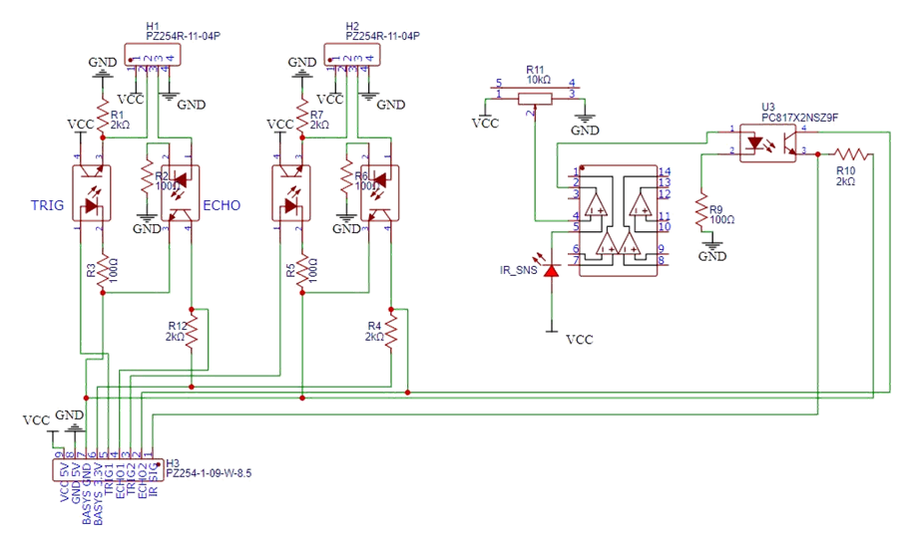
Infrared Detection – Circuit
Phototransistor is optocoupled to the BASYS board to receive infrared signal detected
Pulldown resistor to reduce noise
Potentiometer and comparator used to tune strength of incoming infrared signal

Slide 29
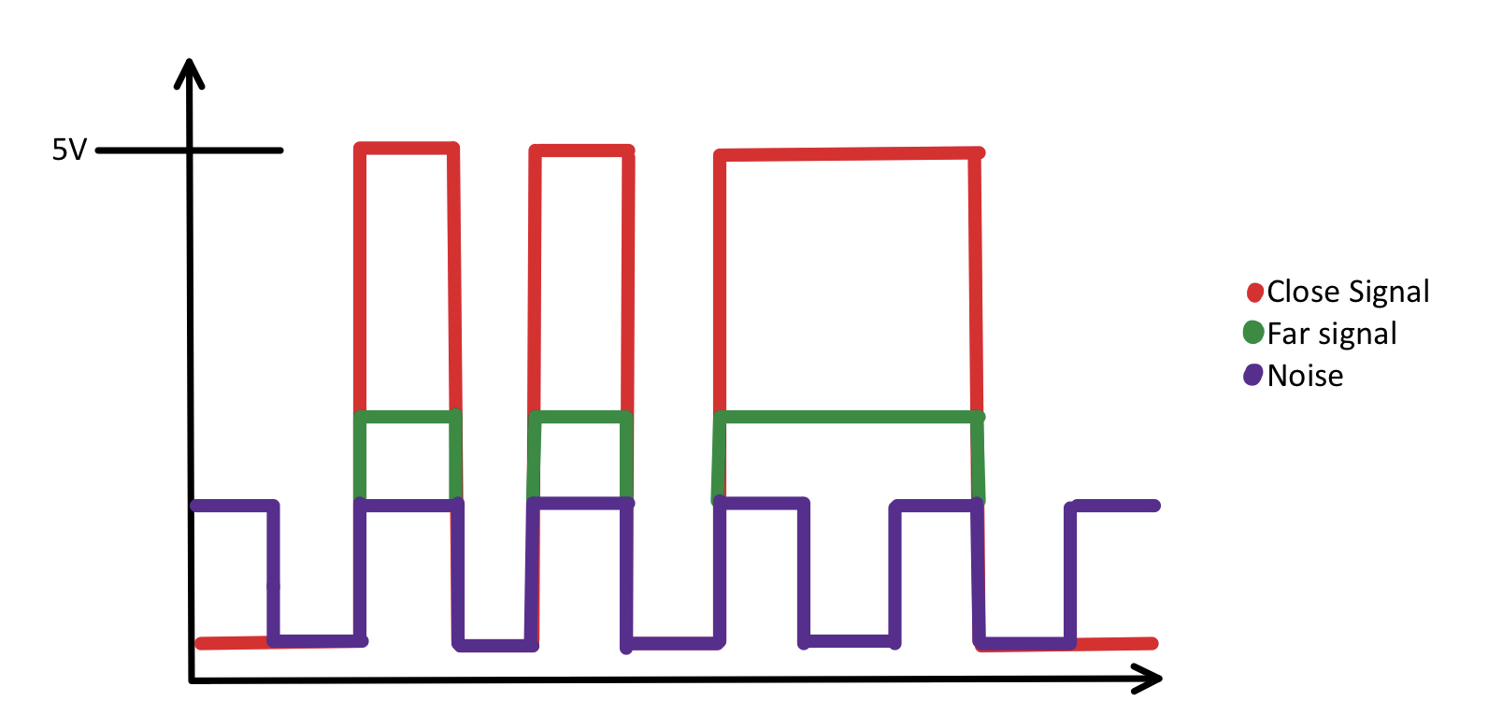
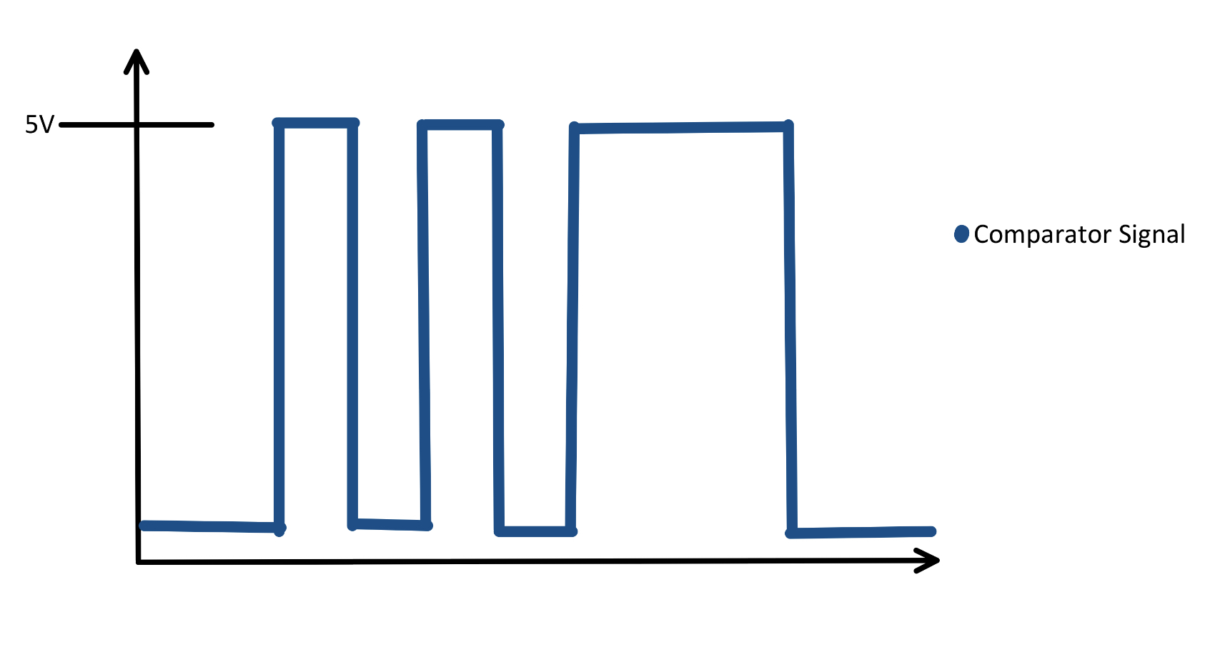
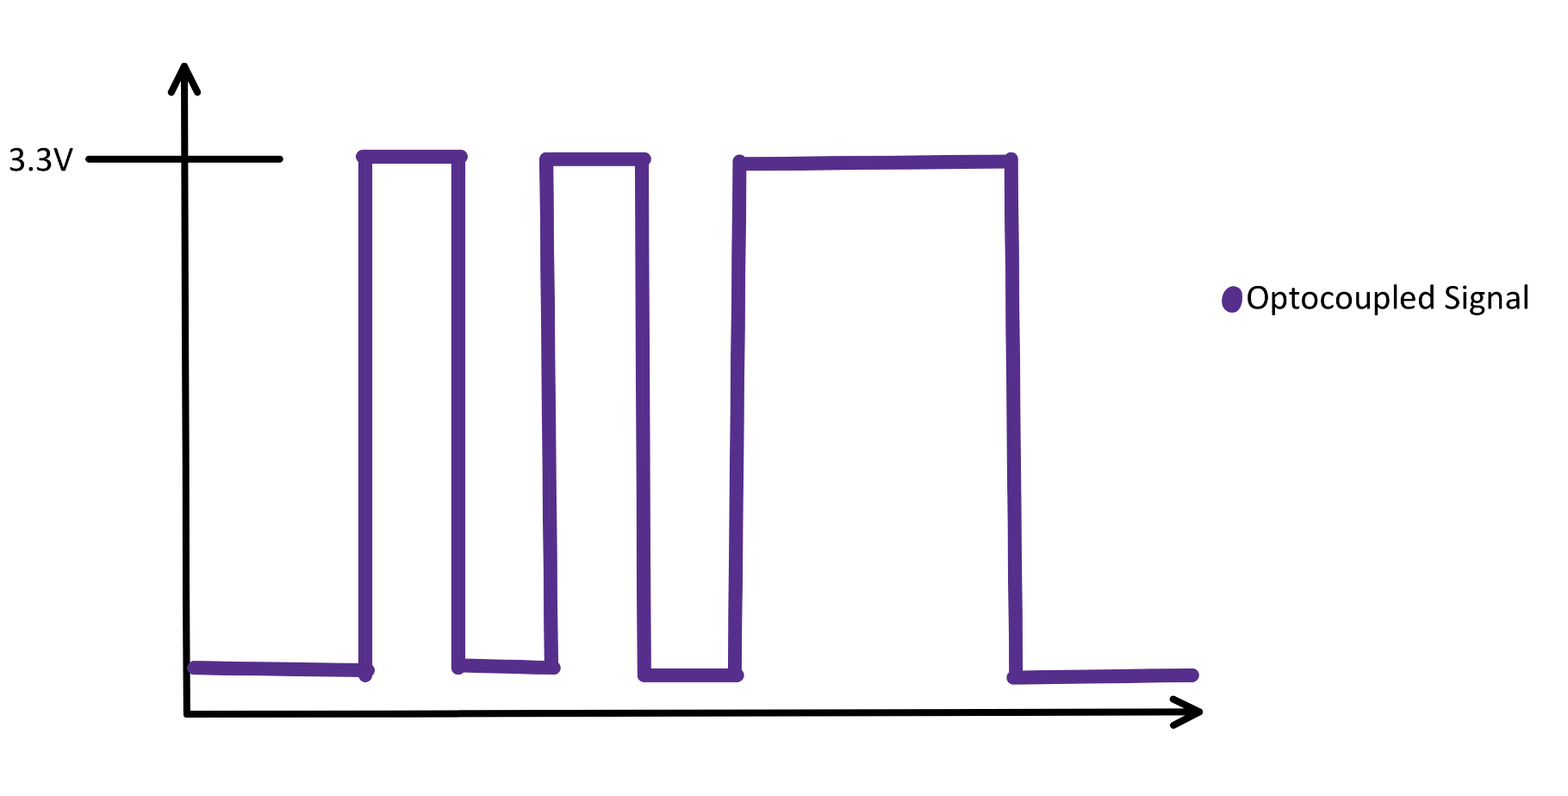
Infrared Detection – Signal Reception
1st panel: signal seen by IR sensor
2nd panel: signal filtered by comparator converted to 5V digital
3rd panel: 5V signal converted to 3.3V digital

Slide 30
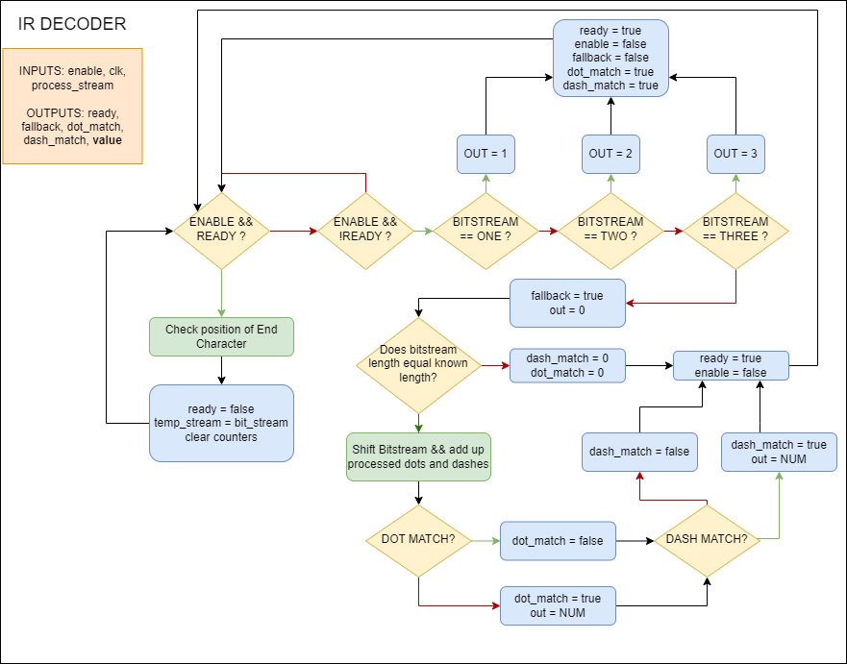
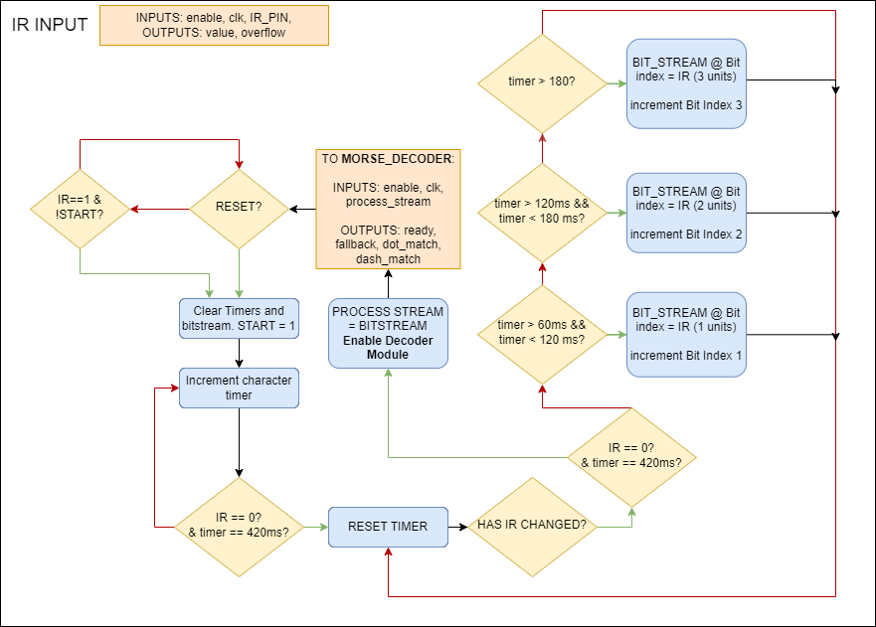
Infrared Detection – Verilog Modules
Module only activates after successful bin detection
Module stores inputs from OP593 into a register
Once a high value is read, the module will seek out the 7-character space being transmitted before and after the morse number
Module then isolates the data between the two spaces and counts the number of dots and dashes, which are read as high signals of 1 or 3 units wide respectively

Slide 31
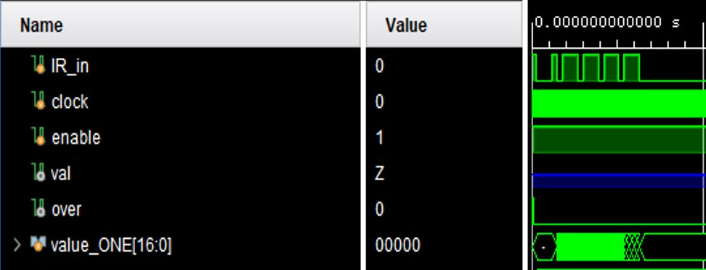
Infrared Detection - Debugging
Morse decoding module does not currently detect input
Not a hardware issue, as the phototransistor functions perfectly
Given the “Don’t Care” output of “val”, it was determined that the input from the phototransistor was never instantiated
Work can now begin on demonstrating module functionality in practice

Slide 32
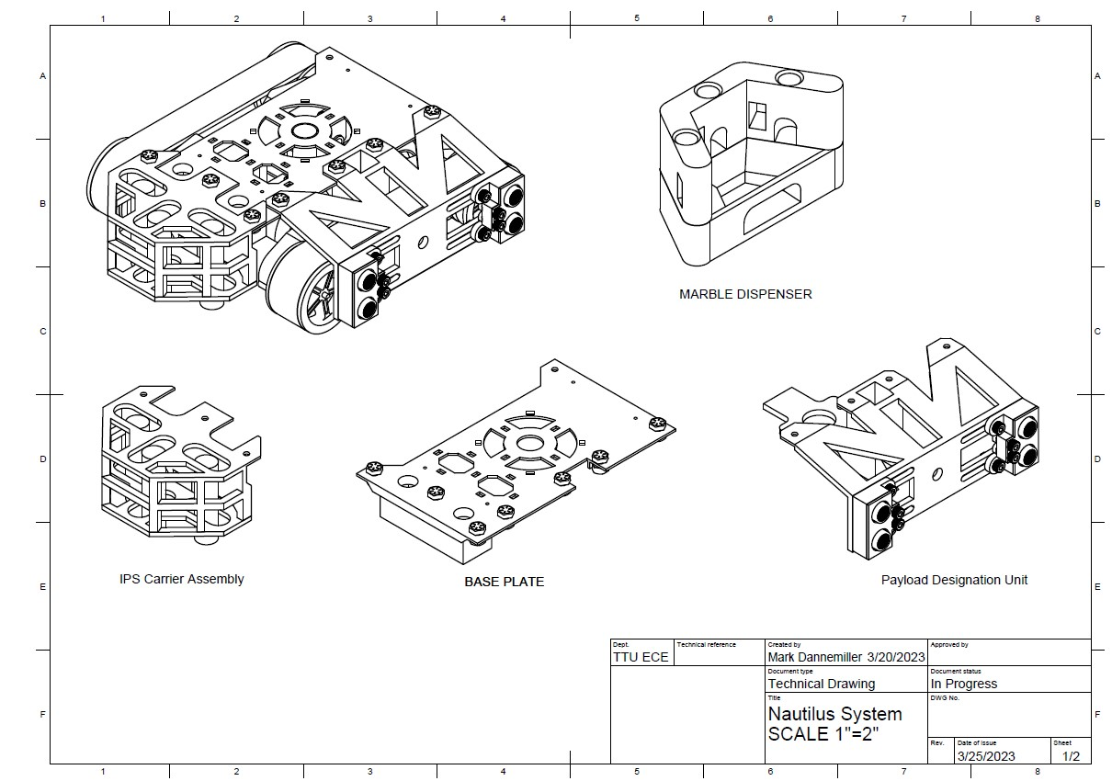
Current Modular CAD Design
Several modules have been designed to accommodate each of the critical operating systems on the rover
These systems are attached via ¼” through bolt connection points which are modular and easily accessible / removable
This system is easily prototyped and modified via 3D printing technology

Slide 33
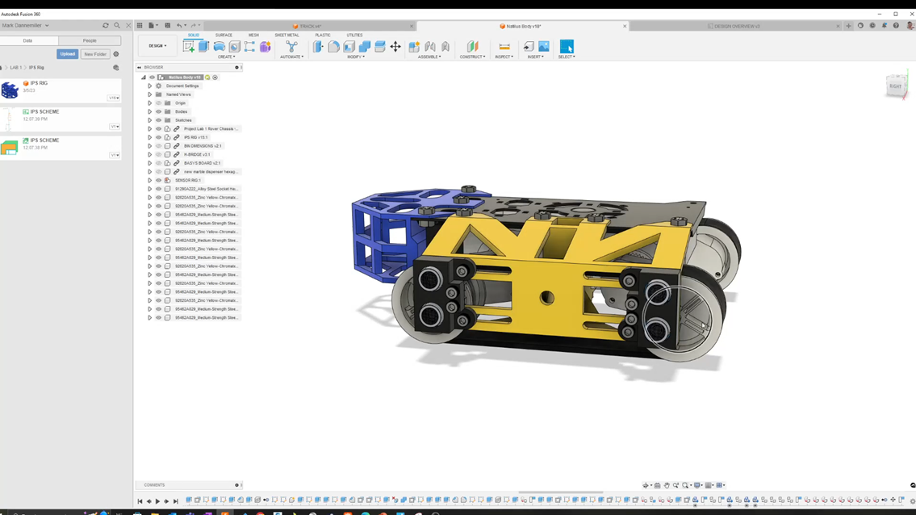
Payload Designation Unit
video

Slide 34
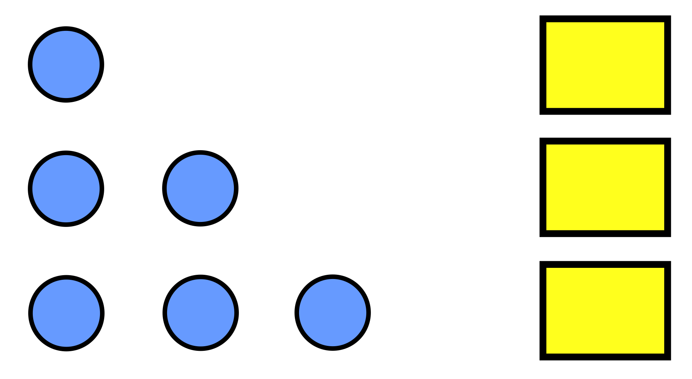
Marble Dispenser - Components
HOURS WORKED: 70
Design marble storage
Select marble delivery method
Design a circuit to release marbles
Develop a Verilog module to release the requisite number of marbles
Send enable signal to track navigation module
Design and print dispenser housing
BIN 1
BIN 2
BIN 3

Slide 35
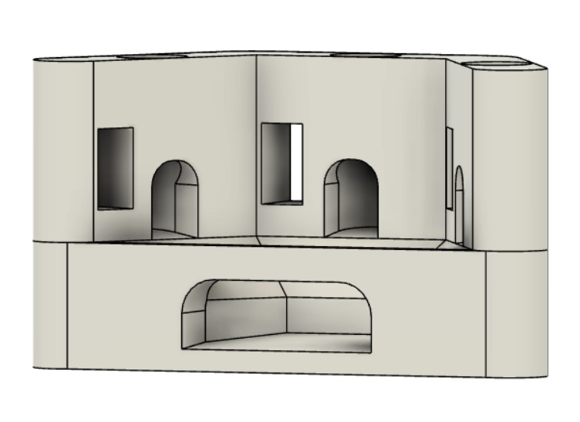
Marble Dispenser – Storage & Delivery
Decided on 3 connected silos to house the 3 numbers of marbles
Each silo will have an SG90 servo to hold the marbles in the silos and rotate to dispense them on command
The silos will dispense into a central location attached to a ramp positioned over the bin

Slide 36
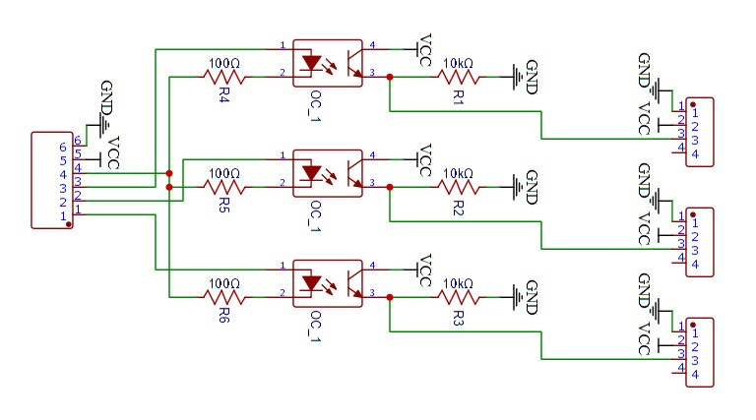

Marble Dispenser - Circuit
Servos require 5 V of power to operate
An optocoupler is used for each motor connection to translate the BASYS signal
Pull-down resistors are utilized to minimize floating voltage
Decreases wires traveling from marble dispenser to the central core of rover from nine to six

Slide 37

Marble Dispenser – Verilog Module
Module receives the number of marbles to dispense from the morse decoder module
Based on the input, the appropriate servo will rotate into the open position, dispensing the marbles contained in its silo
Once dispensing is completed, after a short delay the rover will resume track navigation

Slide 38


Public Github Repository
DAGU Rover 5 3D model is available!
BASYS 3 vector file is available!
Full repository is public!

Slide 39


Resources for Future Classes
video

Slide 40

Comprehensive HDL Layout

Slide 41
PCB Schematic

Slide 42


PCB Design

Slide 43

Current Rover 3D Model
Codename: Nautilus
416 hours worked
Estimated completion date: 4/10/2023

Slide 44

Current Rover 3D Model
Server-rack style PCB body mount still under development
Power distribution, Basys 3, and H-bridge shall be mounted onto base
Marble dispenser shall be placed as shown with ramp extension to bin

Slide 45

video

Slide 46
Next Steps
Design tiered body system inspired by server cabinets to house critical systems
BASYS 3
H BRIDGE
POWER DISTRIBUTION PANEL
Display result of morse decoding module on BASYS seven segment display
Receive ordered PCB
Assemble rover
Create another PCB board for debugging LEDs and more 7-segment displays
Thank you!

